Slide 1
Validation Kickoff Diagnexia
Internal - 2025 Dec 15
Armaan Singh & Jamie Nowacek
QA / RA
Armaan Singh & (Jamie Nowacek)

Slide 2


AGENDA
Risk approach planning
Validation framework
Preventative Quality Focus
Benefits
Audit finding: record retention location(s)
Divide CAPA into phases - next steps
Quiz!
For time, save Questions
for the end.
Notes:
The goal of this initiative is to modernize and standardize validation so that all Diagnexia systems and workflows consistently perform as intended. We’ve seen in audits that inconsistent SOPs, outdated OPQs, and fragmented documentation have created confusion and risk.
(QA) Speaker Note:
Validation ensures Diagnexia’s digital pathology systems, workflows, and tools perform as intended.
Uniform validation processes reduce confusion caused by inconsistent SOPs, misaligned terminology, and OPQs not matched to the current model.
Risk Based Validation:
We only perform validation testing when the change introduces real risk to patient safety, data integrity, or regulatory compliance.
When risk is low, we justify NOT testing and instead use documentation, training, or configuration review.
The first part of our approach is the Risk Plan. This is where we shift to a fully risk-based validation method. High-risk changes—those impacting patient safety, image quality, data integrity, or intended use—will require testing. Low-risk changes will instead be justified through documented rationale, configuration review, or training. This lets us focus effort where it matters while eliminating unnecessary testing.
Our focus should be on establishing unified expectations for documentation, templates, testing, and evidence so every validation activity follows the same model. This includes a global Validation Policy and a U.S. Validation Plan. And importantly, all validation records will be retained in Orcanos for transparency, traceability, and audit readiness.
And finally, the preventative quality focus is accomplished by understanding that validation is not just a regulatory requirement but also a preventative control within our QMS. By applying risk-based validation consistently, we reduce variance, decrease signature burden, shorten validation cycles, and help ensure all testing aligns directly to intended use. This makes our processes more defensible, scalable, and predictable as Diagnexia grows.
Although this approach is US centric but the hope is to take this to the global level.

Slide 3



Why is this topic important to Deciphex?
<Armaan can use this space to draw out the Deciphex connection to the pictures on the right>
how does this tie back to Deciphex? - Armaan
test methods are how our patients receive their DX and care from our pathologists
Validating intended use → method is key to supporting strong patient care in the market
Preventive quality focus → records to support Audits → prevents failed license or permits
Patient safety: Testing was unreliable but she went to market anyways
Patient fraud: He hiked prices & then committed security fraud
Notes:
Dollars over patient safety examples
The Theranos scandal involves the rise and collapse of a Silicon Valley blood-testing startup that misled investors, regulators, and patients about the capabilities of its technology. It has become a major case study in corporate fraud, ethics failures, and weaknesses in startup and healthcare oversight.​
What Theranos Claimed
Theranos, founded in 2003 by Elizabeth Holmes, claimed it had invented devices (often called “Edison” or “minilab”) that could run hundreds of blood tests from just a finger-prick of blood. The company said this would make testing faster, cheaper, and more accessible in pharmacies and clinics.​
What Actually Happened
In reality, the technology could not reliably perform most of the tests Theranos advertised, and many tests were secretly run on modified commercial machines using larger blood samples. Internal concerns about inaccurate and unsafe results were raised by employees and later corroborated by whistleblowers.​
Exposés, Regulators, and Shutdown
Investigative reporting in 2015 revealed that Theranos was not using its own technology for most tests and that its devices produced unreliable results. Regulators then found serious laboratory quality problems, banned Holmes from operating a lab for two years, and the company ultimately voided many test results and shut down in 2018.​
Fraud Charges and Sentences
U.S. prosecutors charged Holmes and former president Ramesh “Sunny” Balwani with wire fraud and conspiracy, alleging they knew the technology was unreliable but continued to market it to investors, doctors, and patients. Holmes was later convicted of defrauding investors and sentenced to more than 11 years in prison; Balwani was also convicted and sentenced in a separate trial.​
Why the Scandal Matters
The Theranos case exposed how hype, secrecy, and weak governance can allow a health-tech company to grow to a multibillion‑dollar valuation despite unproven technology. It has led to calls for stronger scientific validation, board oversight, whistleblower protection, and regulatory scrutiny in healthcare startups
+++++++
Martin Shkreli, a former pharmaceutical executive in the U.S. widely known as the “Pharma Bro.” He became infamous for hiking the price of the drug Daraprim by roughly 4,000–5,000% and later went to prison for securities fraud.​
Who Martin Shkreli Is
Martin Shkreli was CEO of Turing Pharmaceuticals (later Vyera) when his company obtained rights to Daraprim, a decades‑old drug used to treat toxoplasmosis and often prescribed for HIV and other vulnerable patients. Soon after, the company raised the price per pill from around $13.50 (or $17.50, depending on the source) to $750, sparking public outrage and political scrutiny.​
Why He Went to Prison
Although Shkreli became the face of drug price gouging, his prison sentence was for securities fraud related to his hedge funds and a previous drug company, not directly for the Daraprim price hike. In 2018, he was sentenced to 7 years in federal prison and ordered to forfeit millions of dollars in assets.​
What Happened After
Regulators and courts later found that Shkreli’s conduct around Daraprim violated antitrust laws, ordering him to repay about $64.6 million and banning him for life from the pharmaceutical industry. He was released from prison to a halfway house in 2022 after serving about five years of his sentence

Slide 4
Topic - introduction
Quality
Regulatory
Risk plan
Implement risk-based validation
Define when testing is required vs. when justification is sufficient
Apply consistent risk approach using DMS-105073
Validation Framework
Unified expectations for documentation, templates, and evidence
Global-to-regional structure (Validation Policy → U.S. Validation Plan)
Centralize validation records in Orcanos
Preventative Quality Focus
Use validation as a preventive QMS control
Reduce variance, signatures, and validation cycle time
Strengthen alignment to intended use and risk
Benefits
FDA: least burdensome approach in testing
Focused testing on intended use
Reduce medical director signatory
Audit finding: record retention location
omission of testing = risk justification
Preventative RA focus
Divide CAPA into (2) phases:
Focus on Preventative with Quality
Focus on Record retention with Regulatory
Next steps…. (Schedule / Milestones)

Slide 5






Current Validation Gaps QA Must Address
Inconsistent and outdated validation practices
Missing or dispersed validation records
SOPs and OPQs misaligned with current operations
Lack of standardized risk assessment for testing decisions
Excessive signatures and long validation cycle times
Notes:
Speaker Notes:
On this slide, I want to clearly outline the problems QA is addressing with the new validation model.
First, our current validation practices vary significantly by system, by region, and even by individual reviewer. Some OPQs were created before CLIA certification and no longer reflect our operational model. This inconsistency creates confusion, rework, and audit vulnerability.
Second, validation records have been found in multiple locations, sometimes outside IMS or Orcanos. This makes it difficult to demonstrate compliance and traceability. One of the audit findings explicitly called out missing or unclear record retention.
Third, our SOPs and supporting documents do not fully align with how Diagnexia currently operates, especially around digital pathology workflows, integrations, and telepathology. Updating the validation framework gives us the opportunity to modernize and correct that misalignment.
A fourth gap is the absence of a standardized, documented way to determine when testing is required versus when justification is sufficient. Without a consistent risk assessment, people tend to over-test or under-test, and that inconsistency increases risk.
And lastly, our validation cycle times have been far too long. Excessive signatures, repeated testing, and unclear templates have created unnecessary delays. QA is solving this by implementing a structured, risk-based approach that reduces variance, improves turnaround time, and strengthens our defensibility in audits.

Slide 6

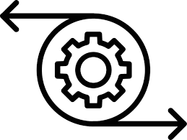
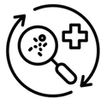



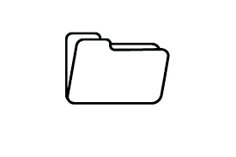
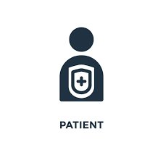





Current Process Gaps QA Must Address
Med Lab Director authorized
Reduce Testing cycle time
Centralize record retention
Lab
Integrations
(6) OPQs
Integrations
Clinical
Equipment
Clinical
Plan took ~ 6 months
~ 20 days
Customer
Replace this time burden with
(1) Plan to fit all future testing
Testing
Protocol
ID created
Report approval
Lab
“This <method, equipment> is ready for patient clinical testing”
Software
Telepathology
Average: 140d = ~ 7 months
VALIDATION
Orcanos
Keep lifetime + 2 years
Intended Use Statement
Aligns intended use to the patient testing
Aligns to FDA “least burdensome” approach, aka “risk based”
Aligning the Validation to the QMS (CAPAs, Audits, ECOs, DCOs)
Notes:
MED DIRECTOR AUTHORIZED for all validation types
Tie all validation types to a single Lab Med director signature
Creates a compliance thread to the entire service/product
Reduce planning cycles - focus time on testing
Current process:
TAT: design to approval: [7] mo
Risk based testing focus
Least burdensome - FDA
Shift resource labor
Quality driven planning
OPS time is focused on testing
Align to e-QMS record management
As service grows, shift to single signature in Orcanos (try to get away from DocuSign)
DMS-8069 record retention
Multiple testing types for all the variety of testing - standardize to Orcanos
IQs - manufacture scanner
OPQs
PQs - clinical
Software chgs - test methods (SOPs)
LIS & customer tests

Slide 7





QA Deliverables
Delivering Predictable, Efficient, and Compliant Validation
Risk-Based Model
A clear matrix to guide all testing decision
Templates
Standardized documents for a 30-day cycle
Orcanos + CAPA Integration
A single source of truth for all validation records.
Notes:
Speaker notes:
This slide summarizes what QA will deliver through the new validation approach.
First, we are establishing a consistent, risk-based validation model. Regardless of scanner type, integration, workflow, or region, we will use the same criteria to determine when testing is required and when justification is appropriate. This consistency eliminates the ambiguity that created discrepancies in past audits.
Second, QA will deliver unified templates, documentation expectations, and clear record retention pathways. All validation evidence—IQs, OQs, OPQs, telepathology, integrations, and customer validations—will be retained in Orcanos for complete traceability.”
Third, this new model allows for faster and more predictable validation cycle times. By reducing unnecessary signatures and limiting testing to actual risk, we avoid long, repetitive validation cycles that previously took months to complete.
Fourth, our approach directly reduces the approval burden on the Medical Director and other stakeholders. The Master Validation Plan and Validation summary report become the primary approval mechanism, rather than requiring multiple signatures across every protocol.
And finally, we will ensure validation is fully integrated into our eQMS, linking testing requirements and outputs directly to CAPAs, ECOs, audits, and change controls. This alignment reinforces defensible compliance and strengthens Diagnexia’s operational stability as we scale.

Slide 8





Regulatory Deliverables
What is a Regulatory Statement?
A regulatory statement is a brief declaration describing how the company’s digital pathology & telepathology software complies with applicable medical device, healthcare, & data‑protection laws in the regions where it operates, including any limitations on use & regulatory clearances or registrations obtained, based on the validated intended use.
Intended use = Regulatory Statement = Validation
Validation Policy
INTENDED USE
REGULATORY
REG
STATEMENT
No matter where in the world Diagnexia is offered, the intended use will align to the VALIDATION TESTING.
VALIDATION
Notes:
What is a regulatory statement? Backbone of the service. Testing would support the intended that is published in the Reg statement. Qualifications are testing that the equipment works for the intended use - they do not establish intended use.
Rooting the product / service in an anchored Reg statement that indicates “where” we can establish service, while also supporting the intended use with substantiated test methods strengthens the offering in the regional market.
Create consistency with supporting a globally available product / service.

Slide 9



Validation Vision
Unified, risk‑driven program
Standardized, scalable processes
Predictable, efficient lifecycle
Single validation framework replacing legacy practices
Every decision traced to a transparent risk assessment
All records captured and maintained in Orcanos
Common templates, documentation paths, and approval flows
Consistent execution regardless of who performs validation
Validation embedded in the QMS and aligned with growth
Fewer signatures and elimination of unnecessary testing
Shorter turnaround times for releases and changes
Operations, RA, pathology, and integrations move faster with less risk
Notes:
Speaker notes:
To close out the QA section, I want to leave everyone with a clear view of where we are heading.
Our vision is a unified, risk-driven validation program that replaces inconsistent legacy practices with a modern, defensible, and scalable model. Every validation decision—from testing to justification—will be tied to a transparent risk assessment, and every record will be captured in Orcanos.
We will have standardized templates, documentation pathways, and approval structures so that validation doesn’t depend on who performs it or where it occurs. This consistency not only strengthens compliance, it strengthens our ability to grow.
Importantly, validation will no longer sit in isolation. It will be fully embedded into the QMS, linked directly to CAPAs, ECOs, audits, and intended use. This transforms validation into a preventative quality mechanism rather than a reactive one.
And finally, our goal is to deliver a predictable and efficient validation lifecycle. One that reduces signature burden, eliminates unnecessary testing, shortens turnaround time, and enables all teams—operations, RA, pathology, integrations—to move confidently without compromising quality.
This is the future of QA/RA-led validation at Diagnexia, and it is designed to support our scale, our customers, and our compliance obligations as the organization continues to grow.

Slide 10









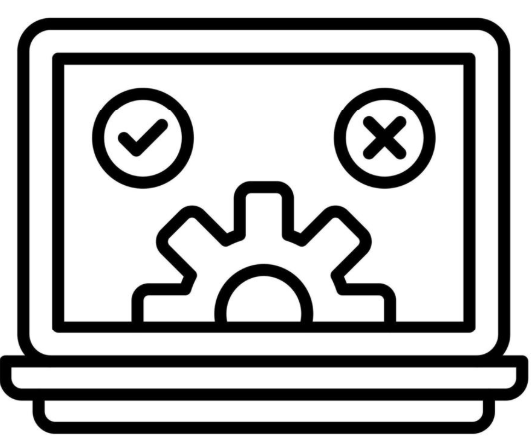







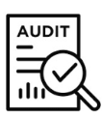

Current process → Impv process
Kaplan
Orcanos
IMS drive
Freshdesk - template
New DMS#
Testing
Freshdesk - route
Test Report Approval
Record archive
Upload
Chicago drive
DMS-8069 - ?
X
X X
X X
Impv Process
DGX becomes a Quality driven service with supported risk assessments.
Orcanos
01
Freshdesk - TPL
New DMS#
Testing
Freshdesk - route
Approval
Record retention
1x set up for (5) documents. Thereafter, revise only if change in intended use.
Repeat for each high risk test
Master Validation Plan
Validation Summary Report
Risk
1x
Reduced by 4 steps!
Further reduce Dr. Kaplan’s signature each rotation!
Reduce to (4) people
for test cycles
02
Quality Plan
03
Regulatory Statement
“Intended use”
Validation Summary Report
Kaplan
Orcanos
Medical statement
Notes:
Risk: DMS-105073.xx - QA driven document
Master Validation Plan - DMS-108833.xx
Template - DMS-109200.xx
Validation Summary Report - DMS-108566.xx
Regulatory Use Statement → needs Fresh desk request - coordinating with Rachel first
Quality Plan - QA document

Slide 11







Next Steps - document collaboration & input
CAPA-107823 → Validation, Reg Statement for Diagnexia (USA)
CAPA-107829 → Validation records
DIVIDE AND CONQUER
Policy: Regulatory Statement
Policy: Validation
DMS-8765
Equipment validation
All Products
Procedure:
Regulatory Statement for Diagnexia
Procedure:
Validation Master Plan
for Diagnexia
Validation Summary Report
Form: Regulatory Statement Diagnexia UK
Form: Regulatory Statement Diagnexia ROW
Form: Regulatory Statement Diagnexia CA
Form: Regulatory Statement Diagnexia USA
DMS-8069
Document Retention
lifetime +2 years
Orcanos
Med director sign
Notes:
Jamie: New Regulatory Statement concept
Jamie & Rachel will tackle the introducing the new Regulatory Statement topic with the business and target Diagnexia, USA first
R.A.l will follow up with the other countries
Armaan: Preventative Quality Focus:
Focus on collaboration with Global on a harmonized Global Validation Policy
Tackle the update to Global Equipment validation procedure updates
Both Jamie & Armaan will focus on “Document retention” that meets all regions

Slide 12
Expected Milestones
Milestone 1
Milestone 2
Milestone 3
Milestone 4
Kickoff: OPS, Intg, Pathology - Jan
Mid Jan 2026
February
TBD
TBD
ECO - “MyDiagnexia+”
QA/RA kickoff - Dec 17
CAPA closure / effectivity
Training
Corrections
Preventative Quality
Validation summary report
Records into Orcanos
LIS records, DocUsign
Chicago records
DMS-8069
Approve
Risk Plan for Diagnexia
Validation Plan - USA
Validation template - USA
Regulatory Statement - USA
Validation Policy
Support Regional docs
Close out CAPAs
Regulatory Statement Policy
Instructor Led Training
OPS, Intg, QA, RA, Pathology

Slide 13

Quiz Time!
The game where points don’t matter
Question #1
Question #2
What do these (2) things have in common?
Master Validation Plan
Regulatory Statement
What can we answer or clarify for the team and the organization?
Risk based Validation
(also accept intended use)

Slide 14
END
North America
Naperville, IL USA

Slide 15
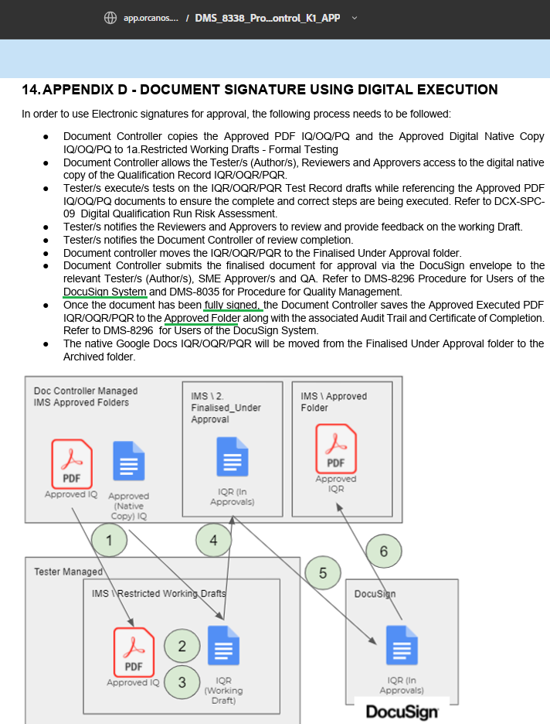
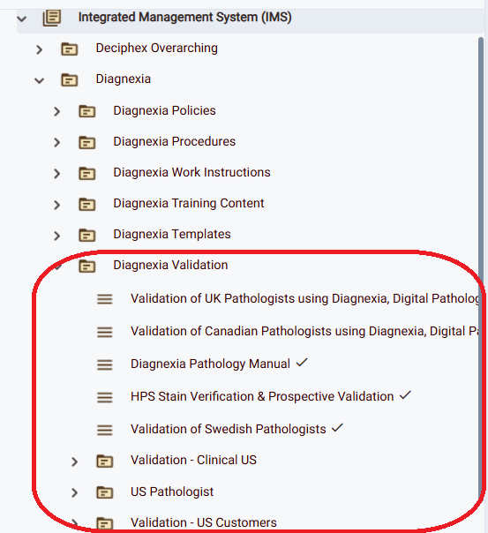
CAI-107828 - VSR correction + retention
COM.40475 Test method validation / verification
COM.30550 Instrument/Equipment Performance Verification
Validation records - (14)
Document retention - DMS-8069
Document control - DMS-8338
(6) IQs + (1) OQ
(1) Telepathology report
(6) OPQ validation records
(1) missing Dr. Kaplan’s sign
DCX-OPQR-20
DGX-OPQR-26 MEMO
Need to bring final medical director signature to all testing performed so far…..
Solution: VSR to tie all together the IQ, OPQs, and telepathology docs so we are compliant to COM.40475
Indicates validation records are retained in Orcanos

Slide 16


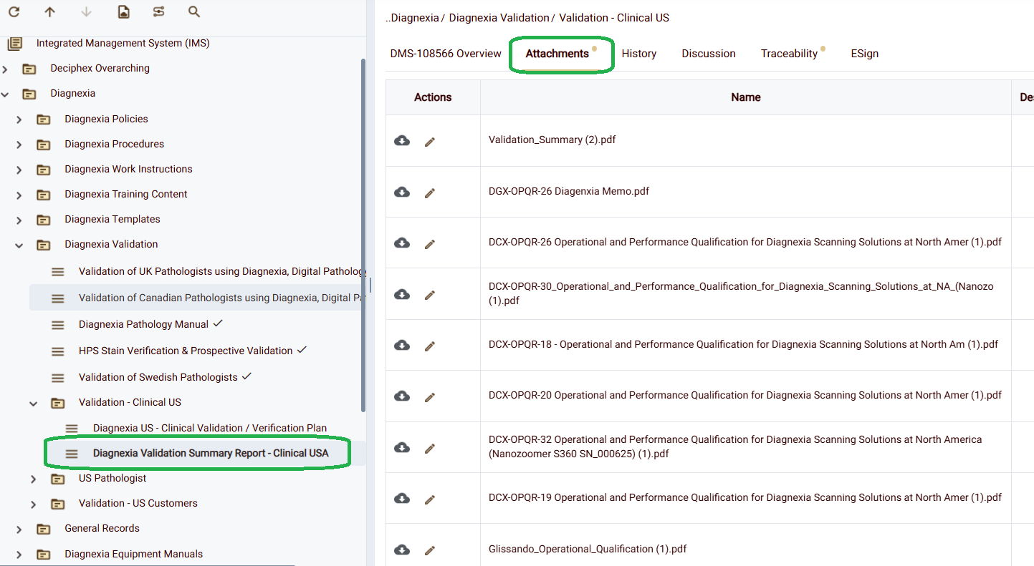
CAI-107828 - VSR correction + retention
This needs to be also on Orcanos
Document control - DMS-8338
All (14) validation records linked
Kaplan
Download
FD#65401
reviewing
DMS-108566 VSR
Dec 5th
Upload to appV folder
approved
Document retention - DMS-8069 - missing process step?
Upload
Orcanos
Orcanos
Route for approval
DMS-108566 VSR

Slide 17
CAPA-107823- document control
Gap Analysis - 03 Dec
2025 - Dec - 01
Orcanos Documents
DMS-8338
Orcanos
Templates
Orcanos
Procedures
Orcanos Records
DMS-8069
Training records
DMS-8082
1
Regulatory Statement
“intended use” DMS-xxxxxxx
CAPA
Lab can test without having to receive pre-approval b/c the Plan + Risk is the approval
Validation Policy
DMS-xxxxxx
CAPA
Testing needed: only if intended use is changed, new SOP, or high risk process change
Summarize to (1) med director sign
RISK BASED - DMS-105073
2
Test not needed, justification based on Risk
GEN.52920
GEN.40475
CAPA
USA: Validation Plan
DMS-108833
DMS-109200
template
Clinical protocol(s)
DMS-xxxxx
*USA: Validation
Summary Report
GEN.52920
CAPA
CAPA
Only test when Risk is HIGH
DMS-8765.H1 - equipment, CSV
DMS-61978
IOQ protocol
IOQ Reports
CAPA
COM.30550, .40250
CAP
GEN.50630 Telepathology validation
GEN.52920 WSI validation
COM.40475 Method validation
COM.40640 - LDT, when applicable
Equipment validation:
COM.30550 & COM.40250
Intg: GEN.42195 “Remote LIS” testing
Record retention
GEN.20377 lifetime + 2 years
3
USA Pathologist
DMS-29682
Telepathology record
USA Pathologist DMS-94327
How can we turn this into a record?
Replace with Training
GEN.50630
US customer Val Plan
DMS-81702
Customer records - validation
GEN.40475
DMS-69916 LIS integrations
LIS records - validation
4
GEN.42195
All validation records retain in Orcanos
Validation customer records
*Medical attestation clinical use

Slide 18
Audfdn-107271 - investigation
Gap Analysis - 12 Nov
CAPA - 107823
CAPA - 107829
Failure to meet requirements
FDA: RUO equipment in clinical Dx
CLIA/CAP regulatory req - evidence
Diagnexia LIS - Security
Vendor intg - testing record(s)
BC / Security (UK → IL → customer)
e-QMS documentation
Record keeping outside IMS
SOPs misaligned to current DGX model
Common Causes
OPQ are dusty - they were performed prior to CLIA certification - the model has changed significantly
Growth: Global approach
RA: Drive intended use
Inefficient use of Tools
Glossary of Terms
RCA
DoE
Validation Policy
Req are different in each country - align at higher level
Regulatory Statement
Bring clarity & unify all regions to common Intended use
Validation Plan
Focus testing per region to meet local req
Orcanos & DocuSign
Under utilization
Align terms to testing objectives
Mixing of terms

Slide 19
Audfdn-107271 - Corrective and preventative actions
Gap Analysis - 24 Nov
CAPA - 107823 - Validation process
CAPA - 107829 - Intg process
Failure to meet requirements
FDA: RUO equipment in clinical Dx
CLIA/CAP regulatory req - evidence
Diagnexia LIS - Security
Vendor intg - testing record(s)
BC / Security (UK → IL → customer) –? ECA only
CAI-107891: VSR - summarize testing already performed
CAI-107830 - FreshDesk + DocuSign - records for e-sign
CAI-107827 - Intended Use statement - R.A. - GLOBAL
CAIs - Corrective
CAI-107825 - Validation Policy - GLOBAL
ECA-108619 Update Security doc to include Integrations + cloud offerings
CAI-107826 - Validation Plan - REGIONAL
CAI-108563 - Validation template(s) - REGIONAL
Dependency
CAI-108564 - BYOD testing → for project deliverable
Dependency
ECO-108614 My Diagnexia
CAIs - Preventative
CAI-107824 - Equipment testing - UPDATE (global)
CAI-107828 - ORCANOS folder naming - DONE

Slide 20
Validation Policy - regional
Regulatory Statement
Bring clarity & unify all regions to common Intended use
RA: intended use statement
Validation Policy
Req are different in each country - align at higher level
Risk
Validation Policy
Validation Plan by location
Focus testing per region to meet local requirements
UK: Val
Plan
ROW: Val Plan
USA: Val
Plan
Canada: Val Plan
IQ, OPQs
DMS-8765.H1
IQ, OPQs
IQ, OPQs
Protocols
IQ, OPQs
DMS-61978
Protocols
Protocols
Protocols
Projects
(ECOs, Risk)
Projects
(ECOs, Risk)
Projects
(ECOs, Risk)
Projects
(ECOs, Risk)
Quality Plan
TRAINING
Orcanos Records
USA Pathologist
UK Pathologist
ROW Pathologist
*USA: Validation
Summary Report
CA Pathologist
UK: Validation
Summary Report
ROW: Validation
Summary Report
Customer records - validation
CA: Validation
Summary Report
TEMPLATES:
ADLC, SSDLC - Release notes (Global)
*Medical attestation on Dgx Hub
Notes:
CAPA-107823- summary
Gap Analysis - 03Dec

Slide 21
Regulatory Affairs - record Intended Use
Regulatory Statement
Bring clarity & unify all regions to common Intended use
POLICY: Deciphex Regulatory Statement for Products & Services
PROCEDURE
Regulatory Statement - Diagnexia
PROCEDURE
Regulatory Statement - Patholytix
PROCEDURE
Regulatory Statement - Diagnexia Analytix
FORM: Regulatory Statement - Diagnexia United States
FORM: Regulatory Statement - Diagnexia United States
FORM: Regulatory Statement - Diagnexia United States
FORM: Regulatory Statement - Diagnexia Canada
FORM: Regulatory Statement - Diagnexia Canada
FORM: Regulatory Statement - Diagnexia United Kingdom
Orcanos Records
TRAINING
FORM: Regulatory Statement - Diagnexia United Kingdom
FORM: Regulatory Statement - Diagnexia United Kingdom
FORM: Regulatory Statement - Diagnexia EU
FORM: Regulatory Statement - Diagnexia EU
FORM: Regulatory Statement - Diagnexia EU
FORM: Regulatory Statement - Diagnexia Japan
FORM: Regulatory Statement - Diagnexia ROW
Validation Policy
Req are different in each country - align at higher level
POLICY: Deciphex Validation for Products & Services
Notes:
CAPA-107823 - CAI-107827
Gap Analysis - 03Dec

